Slide 1

Predicting Housing Prices Using Machine Learning
Jonathon Briggs
Online Portfolio

Slide 2

Project Background
Problem Statement:
How can we predict house prices based on given features?
Dataset Used:
(Kaggle) Housing Prices Competition
Data Set Parameters
80 columns (features) related to House Prices
1,460 Training entries in dataset
Objective:
Build a regression model to predict home prices accurately
Kaggle Competition Landing Page
Notes:
Image courtesy of: https://www.kaggle.com/competitions/home-data-for-ml-course/data?select=train.csv

Slide 3
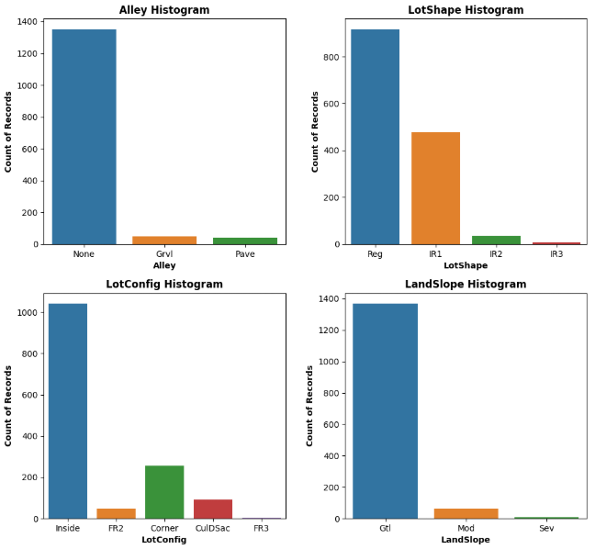
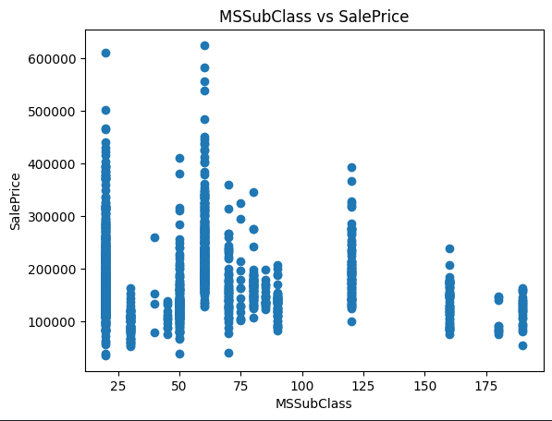
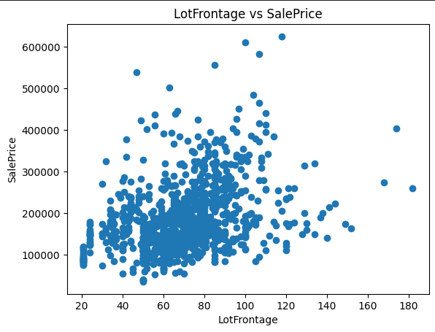
Data Exploration and Cleaning
Visual Exploration:
Charts created and analyzed to inform cleaning steps, find outliers

Slide 4
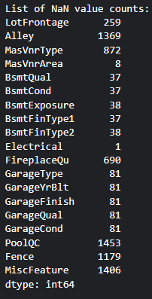
Data Exploration and Cleaning
Missing Data Handling:
Missing fields reviewed and handled with context sensitive decisions using domain knowledge assumptions
19 fields cleaned in total
Field | Definition | Assumptions (Optional) | Missing Count | Fill Decision
LotFrontage | Linear feet of street connected to property | None | 259 | "None"
Alley | Type of alley access | Most locations have no entry (1369 / 1460), indicating this field is MNAR (Missing Not At Random) | 1369 | "None"
MasVnrType | Masonry veneer type | Over 1/2 of locations do not have this entry (872 / 1460), indicating this field is MNAR (Missing Not At Random) | 872 | "None"
MasVnrArea | Masonry veneer area in square feet | This value is depending on the location having a veneer in the first place, indicating this field is MNAR (Missing Not At Random) | 8 | 0
BsmtQual | Height of the basement | All missing records are paired with other Basement null instances and are less than 5% of data set. Context indicates these are homes without basements due to missing data. | 37 | "None"
BsmtCond | General condition of the basement | All missing records are paired with other Basement null instances and are less than 5% of data set. Context indicates these are homes without basements due to missing data. | 37 | "None"
Electrical | Electrical system | Missing data is only 1 record, therefore will fill with the 'Mode' of the data set | 1 | 'SBrkr'
Example of Fields and Cleaning Actions

Slide 5
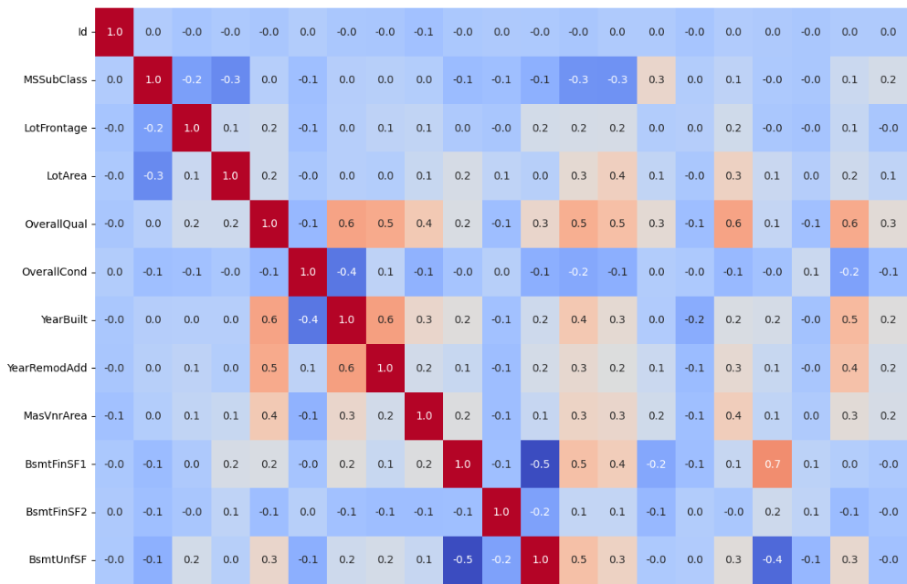
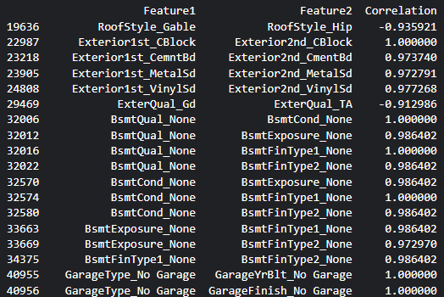
Data Exploration and Cleaning
Correlation + Multicollinearity Review:
Numeric fields were correlation mapped
Categoric fields encoded and evaluated for pair correlations to isolated related features above threshold of 0.9
Example Subsection of Correlation Map
Example Subsection of High Correlation Pairs

Slide 6
Model Preparation
Feature Aggregation and Removal:
6 Fields generated using combinations of original features
13 Features dropped due to correlation or poor performance predictions
New Variable | Calculation
PorchArea | OpenPorchSF + EnclosedPorch + ScreenPorch + 3SsnPorch
TotalBath | BsmtFullBath + .5*BsmtHalfBath + FullBath + .5*HalfBath
HouseAge | YrSold - YearBuilt
HouseRemodelAge | YrSold - YearRemodAdd
TotalSF | 1stFlrSF + 2ndFlrSF + BsmtFinSF1 + BsmtFinSF2
TotalArea | GrLivArea + TotalBsmtSF
Deleted Variable | VIF v1 | VIF v1 | CV Score | Explanation
GarageYrBlt | n/a | n/a | inf | Removing based on domain knowledge
Alley | n/a | n/a | 1.881821 | Based on Poor CV from SelectKBest Test
Street | n/a | n/a | 1.870745 | Based on Poor CV from SelectKBest Test
MiscFeature | n/a | n/a | 1.719447 | Based on Poor CV from SelectKBest Test
PavedDrive | n/a | n/a | 1.639847 | Based on Poor CV from SelectKBest Test
CentralAir | n/a | n/a | 1.572278 | Based on Poor CV from SelectKBest Test
PoolQC | n/a | n/a | 1.07997 | Due to only 7 records with pools
Utilities | n/a | n/a | 0.239796 | Based on Poor CV from SelectKBest Test
Id | 4.108094 | n/a | n/a | Not a meaningful record for price prediction
BsmtUnfSF | inf | n/a | n/a | Due to perfect Multicollinearity with TotalBsmtSF
GarageCars | 36.22776 | n/a | n/a | Due to high multicollinearity with GarageArea
TotRmsAbvGrd | 83.40661 | 82.01768 | n/a | This detail is part of GrLivArea, but also separate in nature
LowQualFinSF | inf | n/a | n/a | Due to perfect Multicollinearity with GrLivArea
Engineered Features
Deleted Features

Slide 7
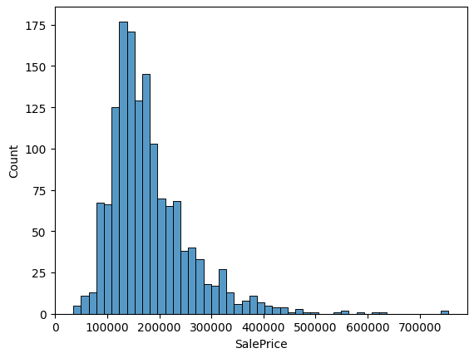
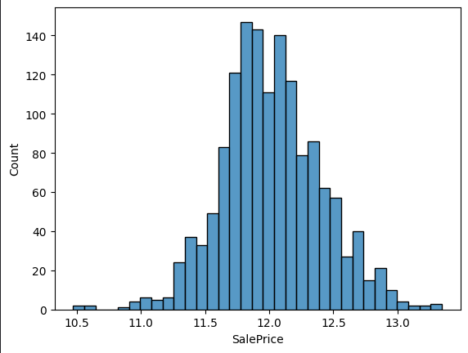
Model Preparation
Encoding and Standardizations:
Categorical Fields were encoded (OHE for Nominal, ODE for Ordinal) via Pipeline
Numeric Fields were standardized using StandardScaler() via Pipeline
Price Predictions were natural log normalized to improve model performance
Original SalePrice HistPlot
Log Normalized SalePrice HistPlot

Slide 8
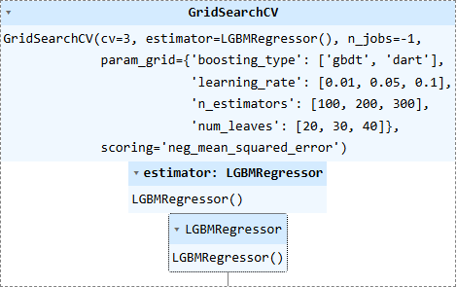
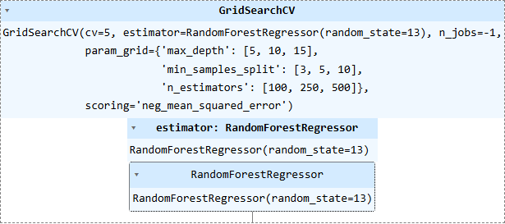
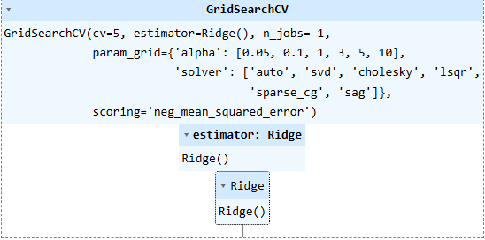
Model Preparation
Model Training and Evaluation:
Utilized GridSearchCV to optimize multiple models
Note: All GridSearch Operations run directly on Kaggle
Created Voting Regressor using GBR, XGB and Ridge best_estimator_ models
Created a Stacking Regressor using all available models
Gradient Boosting Regressor
Xtreme Gradient Boosting Regressor
CatBoostRegressor
Light GBM
Random Forest Regressor
Final Estimator = Voting Regressor
Final model earned Top 200
in Weekly Kaggle Leaderboard
RSME (Score): 13963.31124
Regressor Model Param. Optimizations

